Slide 1

Advanced Concepts

Slide 2
Topics
Memory management in Java
How does garbage collection work?
Requesting garbage collection
Wrapper classes
More on String
StringBuffer / StringBuilder
StringTokenizer

Slide 3
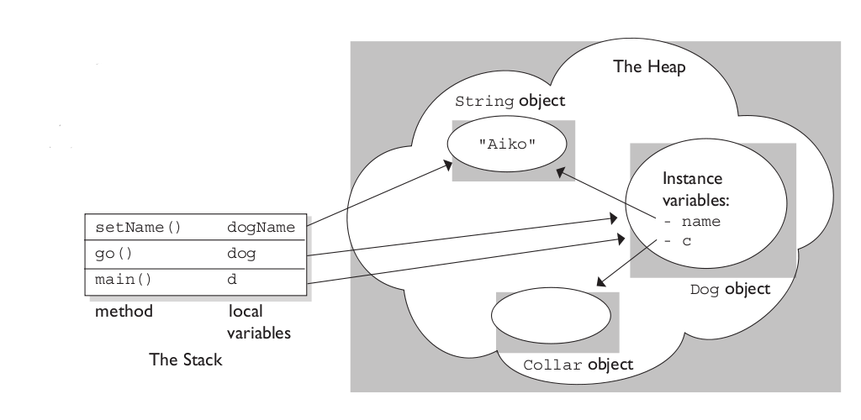
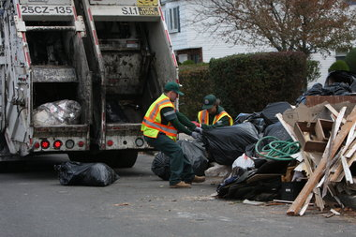
Memory Management in Java
Memory for objects is dynamically allocated
Remember the Heap?
When an object is no longer referenced:
JRE de-allocates the memory for you
Process is known as:
Garbage Collection

Slide 4



How does garbage collection work?
Variables and objects are marked for de-allocation:
When the reference goes out of scope
The reference is assigned to another object
The reference is explicitly set to null
Garbage collector calls Object.finalize( )

Slide 5
Requesting garbage collection
You cannot force garbage collection
JRE collects garbage on its own time
You can only request garbage collection
JRE will collect all objects marked for de-allocation

Slide 6


Requesting Garbage Collection
OR
Could you please free up some memory for me at your earliest convenience? I mean, if you can get around to it.

Slide 7
Wrapper Classes
Let you treat primitive data types as objects
Each data type has a Wrapper class
Primitive Data Type | Wrapper class
boolean | Boolean
byte | Byte
char | Character
short | Short
int | Integer
long | Long
float | Float
double | Double

Slide 8


Using Wrapper Classes
Simply pass a primitive value into the Wrapper constructor
Primitive to Wrapper is called “wrapping”
Wrapper to primitive is called “unwrapping”
Since Java 5, the JRE can perform “auto-boxing”
Wrappers can be directly assigned to primitive variables
And vice versa

Slide 9
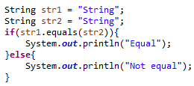

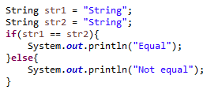
More on String
Strings are immutable objects
Once created they cannot be changed
Compare Strings using the equals( ) method
Using == will compare reference variable memory locations
First output is “Equal”
Second output is “Not equal”

Slide 10
More String Methods
toUpperCase() -Converts all the characters of a string to upper case.
toLowerCase()-Converts all the characters of a string to lower case
charAt(int index) -This returns the indexed character of a string, where the index of the initial character is 0
concat(String s) -This returns a new string consisting which has the old string + s
equals(String s) -Checks if two strings are equal
equaIsIgnoreCase(String s) -This is like equals(), but it ignores the case(Ex: ‘Hello’ and ‘hello’ are equal)
length( ) -Returns the number of characters in the current string.
replace(char old, char new) -This returns a new string, generated by replacing every occurrence of old with new.
trim() -Returns the string that results from removing white space characters from the beginning and ending of the current string.

Slide 11


StringBuffer / StringBuilder
Allows dynamic modification of Strings
Easy to create
Has several String manipulation methods
append
insert
deleteCharAt
setCharAt
Substring
StringBuffer is a synchronized version of StringBuilder

Slide 12
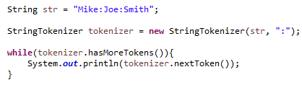

StringTokenizer
Parses a String
Splits into tokens based on delimiter
Second parameter is the delimiter
Delimiter can be any character, or:
Space
\t (tab)
\n (new line)
\r (carriage-return)
\f (form-feed)

Slide 13
Review
Memory management in Java
How does garbage collection work?
Requesting garbage collection
Wrapper classes
More on String
StringBuffer / StringBuilder
StringTokenizer

Slide 14
Assignment
Create a StringBuilder object. Use at least three methods to manipulate the String.
Create a new String with delimited tokens, such as “pickles:ketchup:mustard:onion” and use StringTokenizer to parse out and print each token.
Create two String objects with number values (i.e. “20). Write a method that adds the two.
Request garbage collection in your method.
Create a Runtime object and note at least three methods. Imagine how you would use them.

Slide 15
Data Structures

Slide 16
Topics
Collections
Collections Hierarchy
Collection Interface
List
Set
Queue
Collection classes
Generics
Non-Collection Data Structures
Hashtable
HashMap

Slide 17
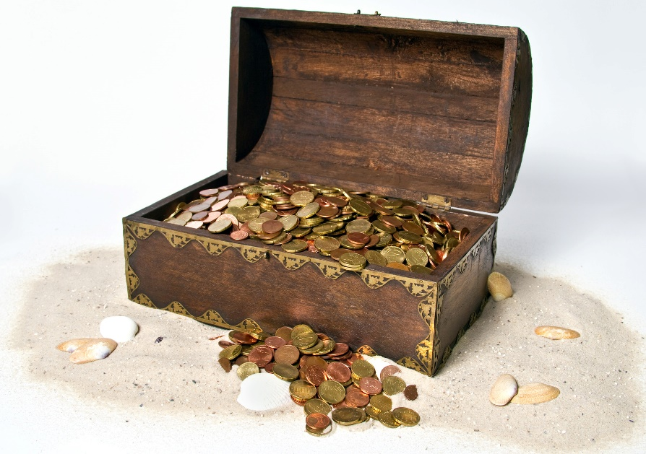
Collections
A collection is an object that groups multiple elements into a single unit
Used to store, retrieve, transform, and manipulate data
Reduces programming effort by providing useful data structures and algorithms
Increases program speed and quality
Collections “collect” things

Slide 18
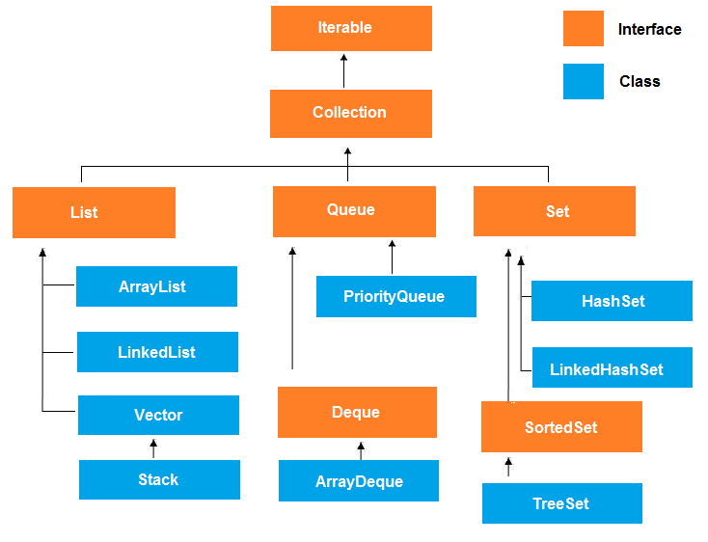
Collections Hierarchy

Slide 19
Collection Interface
add(Object obj)
addAll(Collection c)
clear()
contains(Object obj)
equals (Object obj)
isEmpty()
iterator()
remove(Object obj)
removeAll(Object obj)
size()

Slide 20
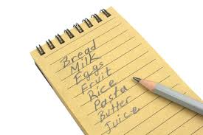
List Interface
Elements can be inserted or accessed by their position in the list
Like array, List uses a zero-based index
May contain duplicate elements
Methods include:
add (int index, Object obj)
get (int index)
remove (int index)

Slide 21
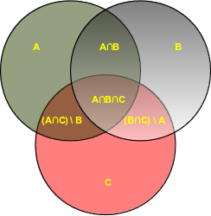
Set Interface
The Set interface defines a collection of distinct elements
Set does NOT allow duplicate elements
Elements are accessed by iterating over the whole set
Methods include:
add(Object obj)
clear()
remove(Object obj)
size()
toArray()

Slide 22
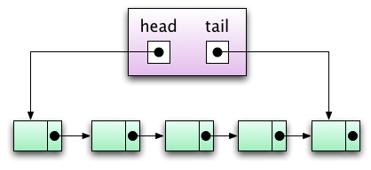
Queue Interface
Places objects on a “waiting list”
Useful for storing objects prior to processing
Elements are added to the tail of the queue
Elements can be popped off the head of the queue
Methods include:
add(Object obj)
element()
peek()
poll()
remove()

Slide 23

Common Concrete Collection Classes
ArrayList – Resizable array; allows fast retrieval by index
LinkedList – Doubly-linked list; each object is a node with reference to nearby nodes
HashSet – Maintains a set of objects; each assigned a hash code
TreeSet – An ordered set of elements
PriorityQueue – Queue ordered by priority

Slide 24


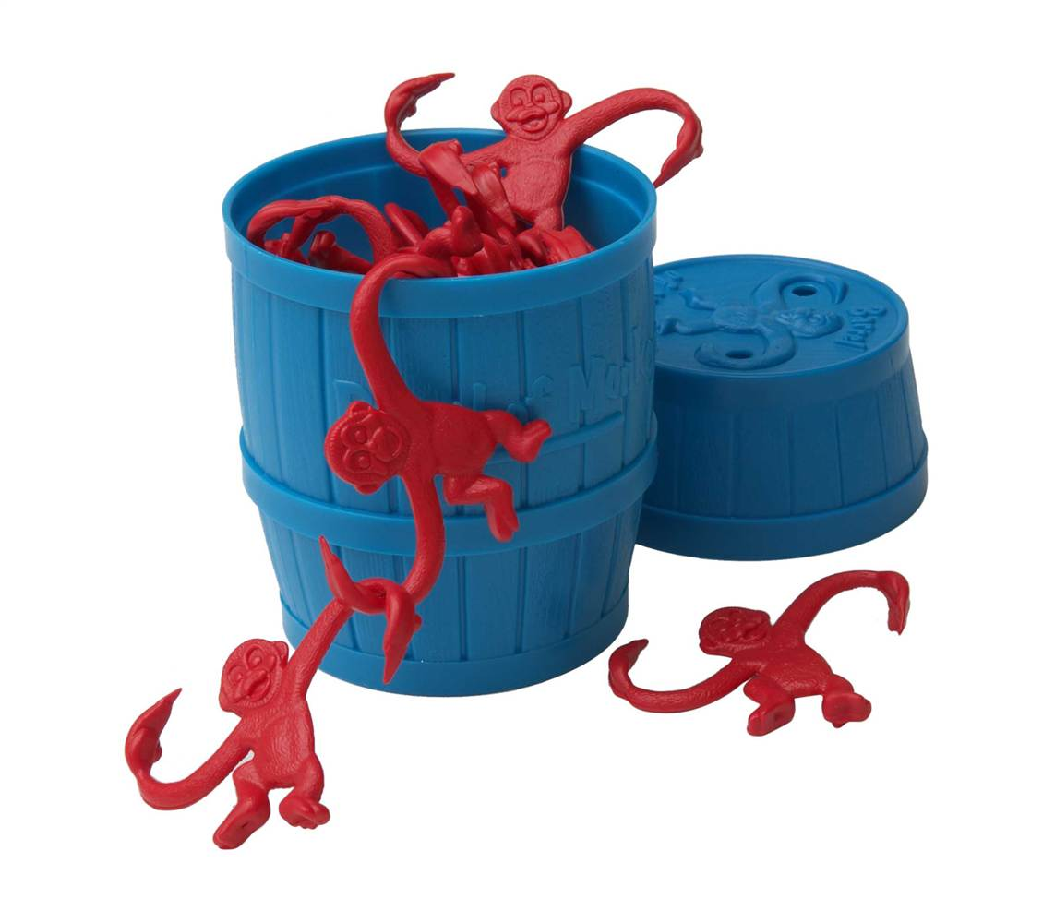
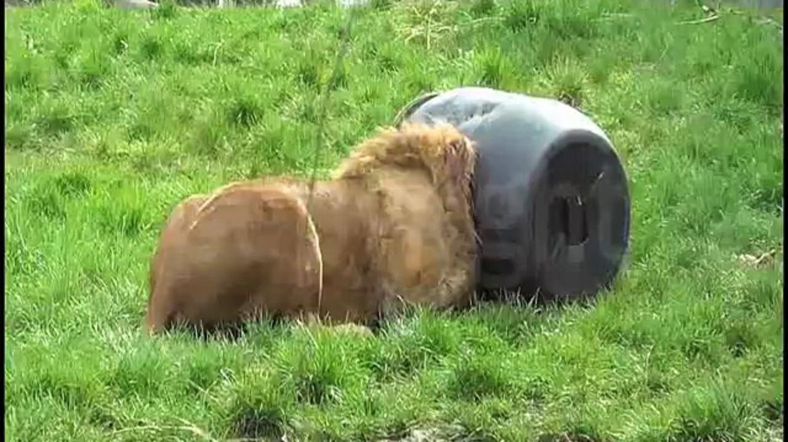
Generics
Generics enforce the type of object allowed in a Collection
Uses the Diamond operator < >
Insert the Class in the Diamond: <Employee>
Generics provide compile-time safety
Notes:
Generics say that: This barrel is for monkeys.
Lions do not belong in monkey barrels…

Slide 25
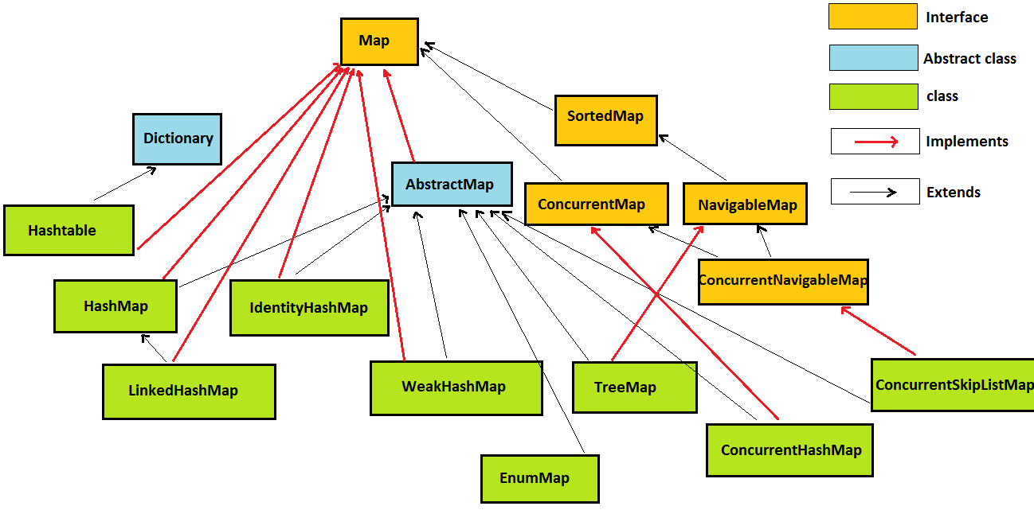
Non-Collection Data Structures

Slide 26
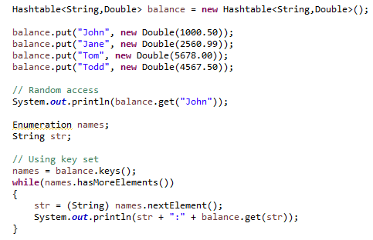
Hashtable
Hashtable stores key/value pairs
When using a Hashtable, you must specify:
An object that is used as a key
The value that you want linked to that key
Allows random access by key
Iterate over key set

Slide 27
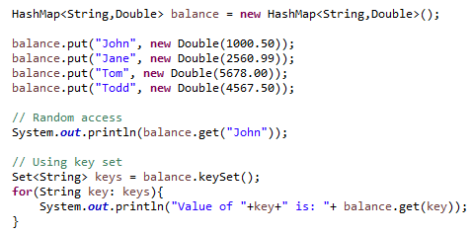
HashMap
HashMap stores key/value pairs
When using a HashMap, you must specify:
An object that is used as a key
The value that you want linked to that key
Allows random access by key
Iterate over key set and get values

Slide 28
Hashtable VS HashMap
Hashtable
hashmap
Thread-safe, synchronized
Does not allow null keys and null values
Uses Enumeration to iterate key set
Legacy class
Not thread-safe
Allows one null key and any number of null values
Uses iterator or for:each loop to iterate over key set
Better performance

Slide 29
Review
Collections
Collections Hierarchy
Collection Interface
List
Set
Queue
Collection classes
Generics
Non-Collection Data Structures
Hashtable
HashMap

Slide 30
Assignment
Create an ArrayList and a HashSet. Insert 3 objects into each.
Iterate over each collection and print each object.
Review Vector and other collections online.
Review Comparator and Comparable in your book or online.
Review java.util.Collections methods (sort, reverseOrder, shuffle, etc.)

Slide 31
Multithreading

Slide 32
Topics
Multithreading
Lifecycle of a Thread
Priorities
Creating a Thread
Runnable interface VS Thread Class
Thread methods
Synchronization
Deadlock

Slide 33
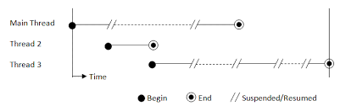
Multithreading
A multithreaded program can have two or more threads running concurrently
Each thread can have its own task
Program becomes optimized and runs faster
OS divides processing time not just with applications but between threads as well

Slide 34
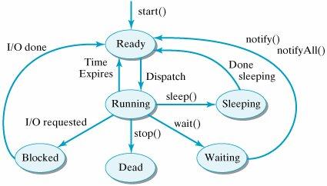
Lifecycle of a Thread
New: A thread’s lifecycle begins. Stays in this state until the program starts the thread.
Runnable: After the thread starts, its in the runnable state.
Waiting: Waits for other threads to complete the task. Will go back to runnable state only when the other thread signals it to continue executing.
Timed Waiting: A thread can be in a waiting state for a specified interval time. It goes back to the runnable state after the time has expired.
Terminated: A thread that completes the task is terminated.

Slide 35
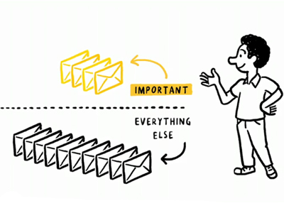
Priorities
Threads can be configured with a priority number which signifies which order threads are to be run in (Range is 1 – 10).
MIN_PRIORITY (typically a 1)
NORM_PRIORITY (defaults to 5)
MAX_PRIORITY (typically a 10)

Slide 36
Creating a Thread
Create a class that implements the Runnable interface
Implement the run() method
Pass an object of it into the Thread constructor
Call the start() method
Create a class that extends the Thread class
Override the run() method
Create an object of the class
Call the start() method
Thread | Runnable
When you want to override other Thread utility methods | When you want to extend another class

Slide 37
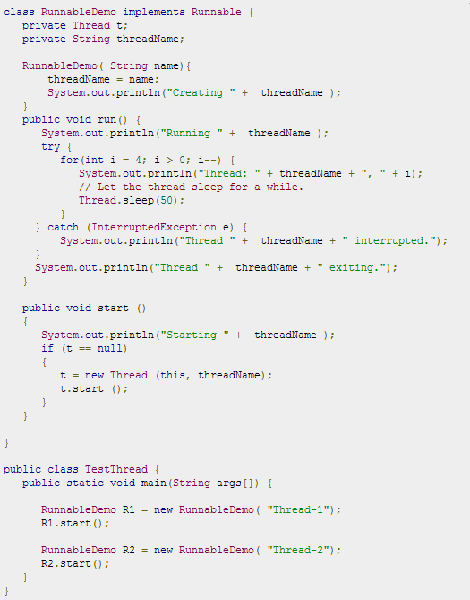
Implementing Runnable

Slide 38
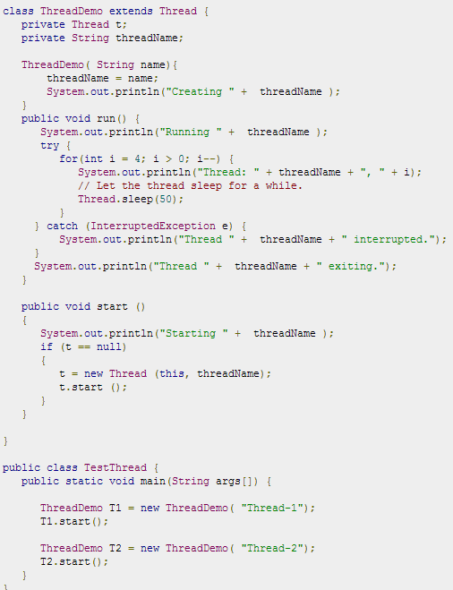
Extending Thread

Slide 39
Thread Methods
Non Static methods
public void start()
public void run()
public final void setName(String name)
public final void setPriority(int priority)
public final void setDaemon(boolean on)
public final void join(long millisecond)
public void interrupt()
public final boolean isAlive()

Slide 40
Thread Methods
Static method
public static void yield()
public static void sleep(long milliseconds)
public static boolean holdsLock(Object x)
public static Thread currentThread()
public static void dumpStack()

Slide 41
Thread Methods
Object methods that threads can use
notify()
notifyAll()
wait()

Slide 42

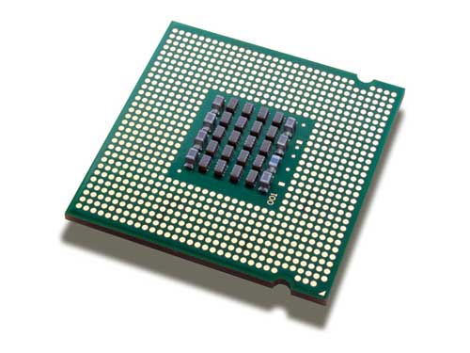
Synchronization
Problem: When two or more threads are trying to access a method or process, a race condition may occur. If one thread is writing data to a file, the other thread may overwrite that data which may cause issues in the program.
Solution: synchronize the action of multiple threads and make sure that only one thread can access the resource at a given point in time. This is implemented using a concept called monitors. Each object in Java is associated with a monitor, which a thread can lock or unlock. Only one thread at a time may hold a lock on a monitor.
The Java programming language provides a very handy way of creating threads and synchronizing their task by using synchronized blocks. You keep shared resources within this block.

Slide 43
Deadlock
Occurs due to resource locking
Thread ‘A’ locks resource ‘1’
Thread ‘B’ locks resource ‘2’
Thread ‘A’ requests resource ‘2’
Thread ‘B’ requests resource ‘1’
Neither thread can continue!
Each holds locks on resources the other needs
Release your lock, man!!
I don’t know you man… you release your lock first!

Slide 44
Review
Multithreading
Lifecycle of a Thread
Priorities
Creating a Thread
Runnable interface VS Thread Class
Thread methods
Synchronization
Deadlock

Slide 45
Assignment
Write a program that creates a thread using either a Runnable interface or Thread class. Have it call a method which prints out numbers from 1 to 10. Hint: Loop the thread.
Write a program which demonstrates synchronization between two threads. Print out the duration a thread has to wait till the prior one has completed. Loop the threads 5 times each.
Review deadlock information in your book or online.

Slide 46
JDBC

Slide 47
Topics
Intro to JDBC
Establishing a Connection
Loading Drivers
Connection Object
Statement
PreparedStatement
ResultSet
Transactions
Commit/Rollback

Slide 48



Intro to JDBC
Java Database Connectivity
Standard framework for handling tabular/relational data
Located in java.sql package
JDBC

Slide 49

Establishing a Connection
The first thing to do is establish a connection with the DBMS
This involves two steps:
Loading the driver
Making the connection

Slide 50



Loading Drivers
Loading a driver is very simple
One line of code
You also need the respective JAR file in your build
Drivers can be easily downloaded online
Notes:
MySQL documentation recommends creating a new instance, which fixes a few broken implementations in the driver.

Slide 51
Connection Object
To make the driver connect to the database:
One line of code
What’s my URL?
Every vendor is different

Slide 52
Statement
Once connected, you can execute SQL statements
A Statement object wraps and executes SQL (including DDL, DML, etc.)
For a SELECT statement, the method to use is executeQuery
To INSERT or UPDATE, use executeUpdate
Review other methods of the Statement class

Slide 53
PreparedStatement
Precompiled SQL statement
Reduce execution time for repetitious SQL statements
Parameterized inputs using ‘?’ placeholders
Easier to read
Database reserved characters automatically escaped
SQL Injection prevention
pstmt.method(Placeholder position, value to insert)

Slide 54
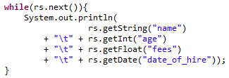
ResultSet
Object that wraps the rows returned by the query
Return type of a query
Loop over the ResultSet to inspect each row
Select each column by “column_name” or column_index
At end of loop, ResultSet points to the next row

Slide 55
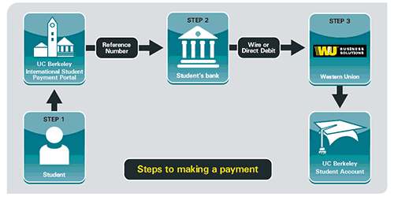
Transactions
ACID: Atomic, Consistent, Isolation, Durable

Slide 56
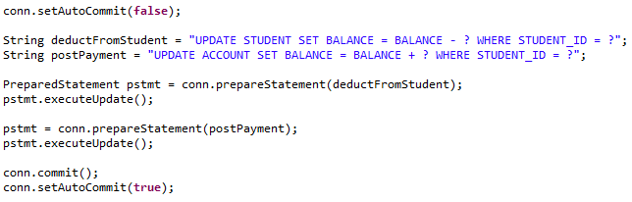
Transactions
JDBC is in auto-commit mode by default
Each Statement is immediately committed
Disable auto-commit mode to execute Statements as a unit
Re-enable auto-commit mode at the end of transaction

Slide 57
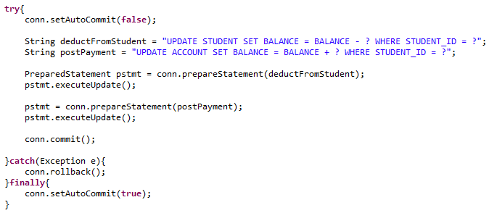
Commit/Rollback
To make changes permanent, use commit( ) method
To return to the previous state, use rollback( ) method

Slide 58

Just like Files…
Always close resources after using them
All JDBC resources have a close( ) method

Slide 59
Review
Intro to JDBC
Establishing a Connection
Loading Drivers
Connection Object
Statement
PreparedStatement
ResultSet
Transactions
Commit/Rollback

Slide 60
Assignment
Create a Connection where the database URL, username, and password is retrieved from a Properties file.
Create a table with at least 3 columns within the Java application.
Insert test data into the table.
Query the test data using Statement and PreparedStatement.
Study CallableStatement for calling stored procedures in your database (PL/SQL, T-SQL, etc.)

